Slide 1
Internship Week 8
Samarth Sharma

Slide 2
Final Summary of all Implementations

Slide 3
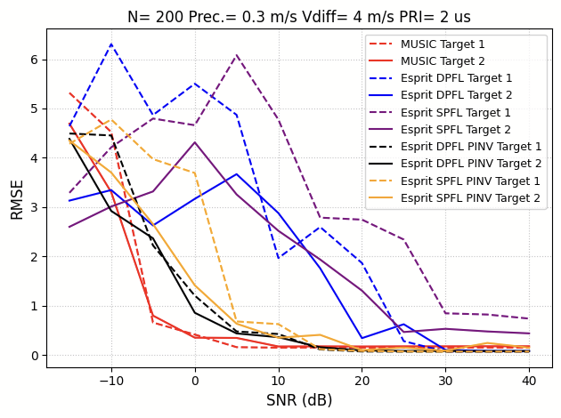
RMSE Comparisons - PS Implementations
MUSIC- SPFL does not work well, DPFL gives low RMSE (lowest among all algos) ESPRIT- Higher RMSE as compared to MUSIC. SPFL performs worse than DPFL. Pseudo inverse implementation gives a lesser RMSE.

Slide 4
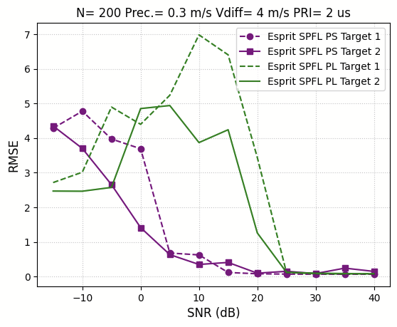
RMSE- PS vs PL - ESPRIT SPFL using PINV

Slide 5
PL Implementations - ZCU111
Implementation | Latency on Vitis (clk cycles) | Acceleration Factor | Resources (BRAM, DSP, FF, LUT) - All in % - Vitis
MUSIC (most optimized) DPFL | 34.97 lakh | 26.73 | 36, 30, 29, 28
ESPRIT (w/o PINV) SPFL | 45 lakh | 30.27 | 8, 6, 3, 9
ESPRIT (using PINV- HLS SVD IP) SPFL | 18 cr | 1.20 | 54, 8, 16, 24

Slide 6
Recreating SubspaceNet results

Slide 7
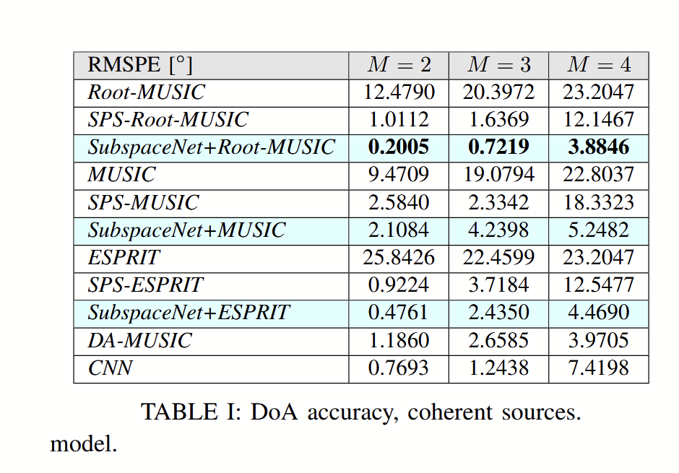
No of samples = 50000
N = 8
Train = 0.9*90% = 81%
Validation = 0.1*90% = 9%
Test = 10%
M = 2,3,4; SNR = 10; T = 100
Signal- NarrowBand, Coherent

Slide 8
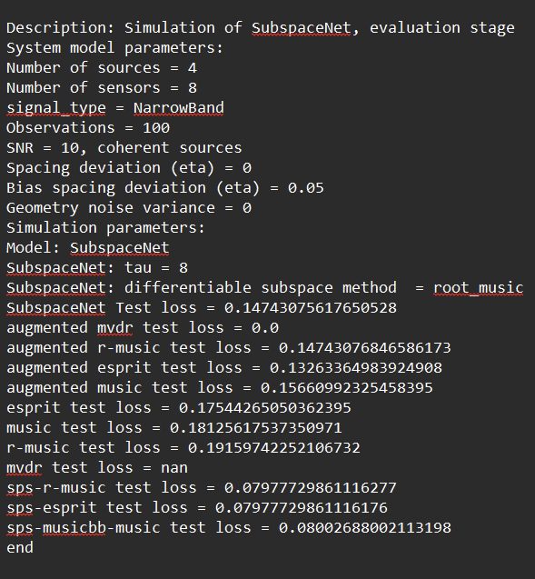
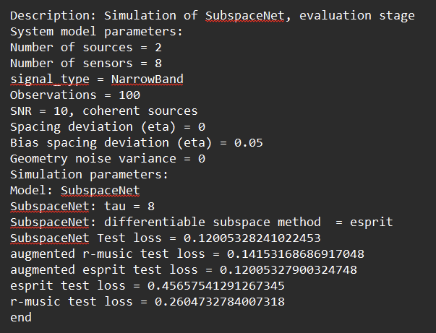

Slide 9
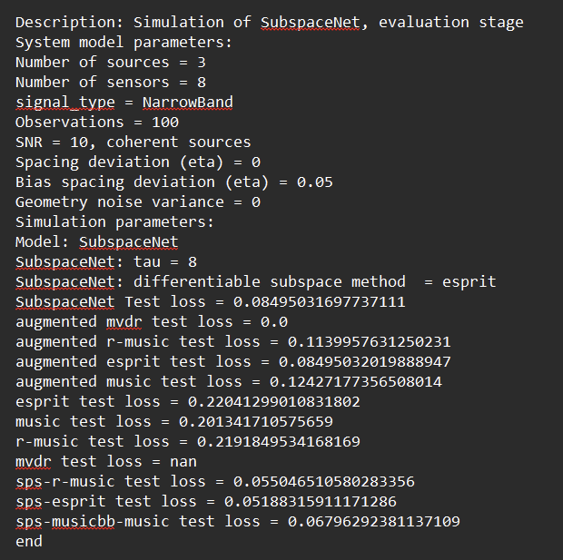
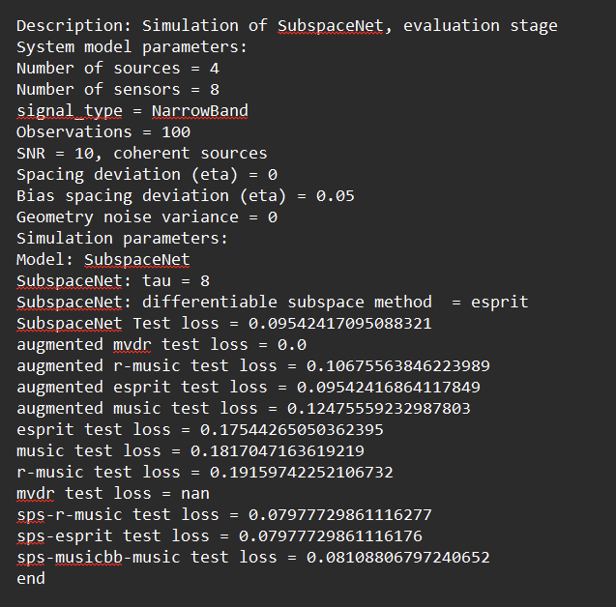

Slide 10
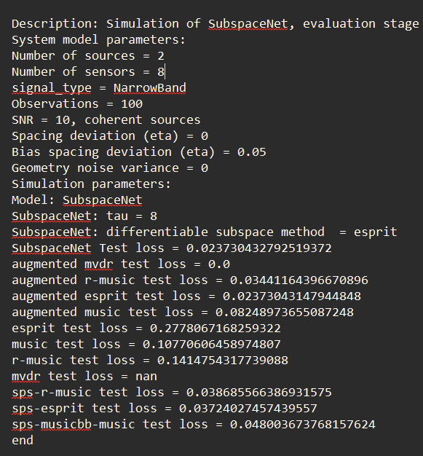
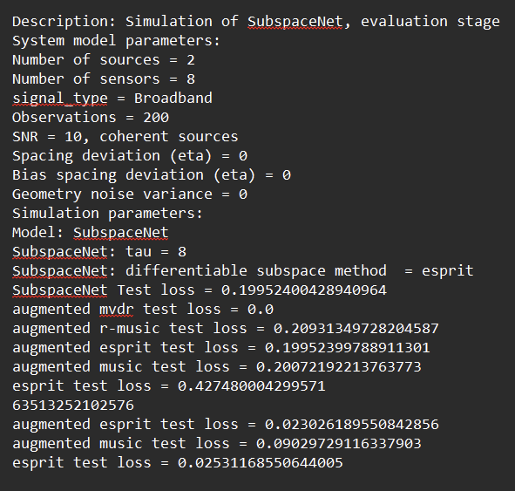

Slide 11
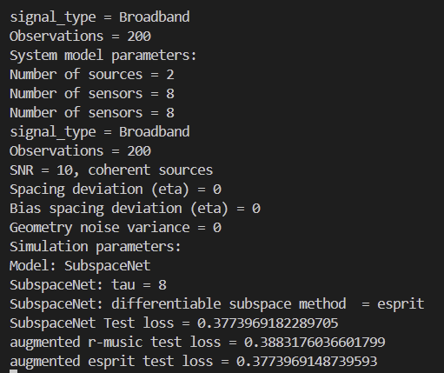

Slide 12
Results Obtained
RMSPE (rad - deg) | M=2 | M=3 | M=4
SubspaceNet+Esprit | 0.19727 - 11.3 | 0.248 - 14.21 | 0.334 - 19.1
SubspaceNet+Root_music | 0.1825 - 10.5 | 0.2871 - 16.44 | 0.3514 - 20.13
Esprit | 0.456 - 26.1 | 0.435 - 24.923 | 0.397 - 22.44
Root_music | 0.26 - 14.9 | 0.416 - 23.83 | 0.41 - 23.49

Slide 13
Thank you!!

